Slide 1

Managerial Accounting
Marcelo Ortiz

Slide 2
Accounting Manipulation
1. Legal vs Ilegal
2. The door of Fraud
3. Earnings Management
4. Signals

Slide 3
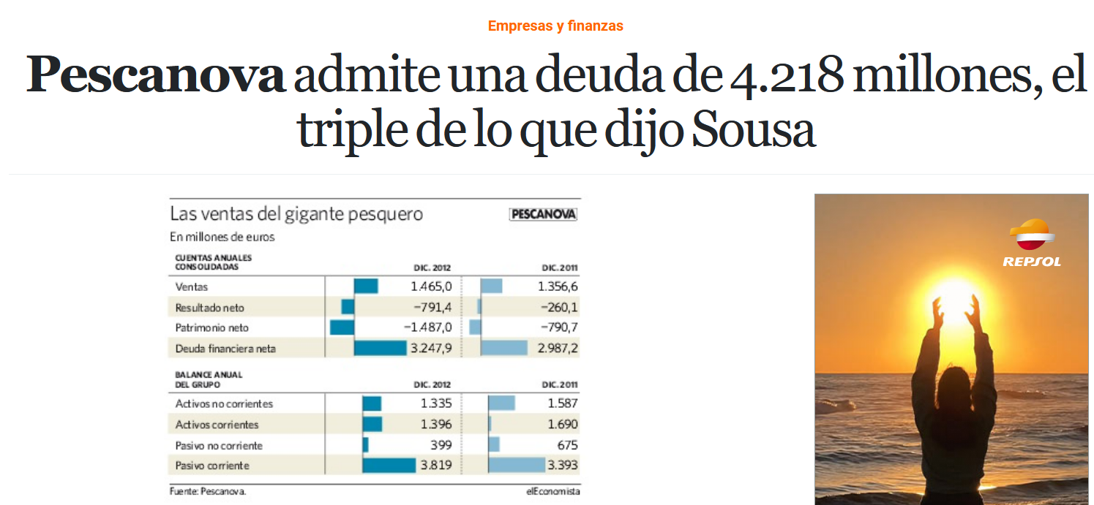
1. Legal vs Ilegal
Source
2. The door of Fraud
3. Earnings Management
4. Signals

Slide 4
1. Legal vs Ilegal
"La crisis de Pescanova, que está en concurso de acreedores, saltó tras negarse parte de los consejeros a firmar las cuentas de 2012 y anunciar la existencia de pasivos ocultos;
(…) ha llevado a reformular también las de 2011 en las que Pescanova, bajo la presidencia de Manuel Fernández de Sousa, ofreció beneficios."
Source
2. The door of Fraud
3. Earnings Management
4. Signals

Slide 5
1. Legal vs Ilegal
"La crisis de Pescanova, que está en concurso de acreedores, saltó tras negarse parte de los consejeros a firmar las cuentas de 2012 y anunciar la existencia de pasivos ocultos;
(…) ha llevado a reformular también las de 2011 en las que Pescanova, bajo la presidencia de Manuel Fernández de Sousa, ofreció beneficios."
Source
2. The door of Fraud
3. Earnings Management
4. Signals

Slide 6
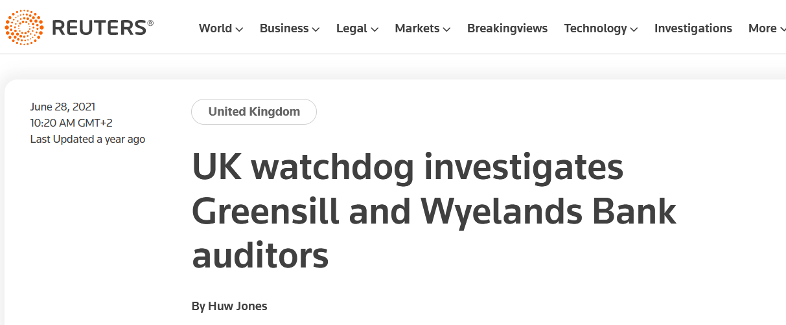
1. Legal vs Ilegal
2. The door of Fraud
3. Earnings Management
4. Signals

Slide 7
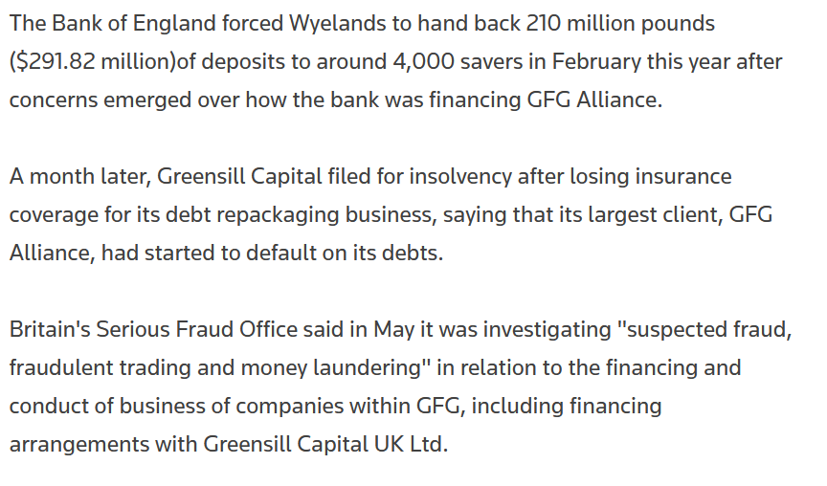
1. Legal vs Ilegal
2. The door of Fraud
3. Earnings Management
4. Signals

Slide 8
1. Legal vs Ilegal
 | ACCOUNTING PRACTICE | REAL TRANSACTIONS
LEGAL | (1) Changing Accounting Criteria: eg., Asset Valuation (2) Optimistic Estimates. Eg, depreciation. | (1) Timing Income/Expenses: R&D projects, advertising. (2) Low quality sales: bad costumer debt
ILEGAL | Accounting Fraud: Eg., Artificial sales, hiding expenses or debts. | Ilegal Transactions: Tax Haven
2. The door of Fraud
3. Earnings Management
4. Signals

Slide 9

1. Legal vs Ilegal
2. The door of Fraud
Accounting Fraud:
- Intentional manipulation of accounting registries and financial statements.
- Objective: mislead about the real economic health of an organization.
- Mechanism: overstating revenues, understating expenses, hiding liabilities, or inflating assets.
- Important: accounting errors are not intentional manipulations, so do not classify as fraud: restatement and fines, but not illegal activities.
Motivation
Opportunity
Rationalization
Source: D. Cressey (1980)
3. Earnings Management
4. Signals
Notes:
Opportunity:
- poor internal controls: internal controls are process implemented to ensure the quality of the accounting information. Problems: lack of supervision or separation of dutties.
- poor tone at the top: of top executives are perceived as noethical, employees will be looking for non ethical opportunities for improving their personal wellbeing.
Motivation/incentives:
- compensation tied to accounting metrics
- stock market expectations
- personal needs or desires.
Rationalization:
-individual’s justification for committing fraud
“They treated me wrong”
“Upper management is doing it as well”
“There is no other solution” (for not losing the job)

Slide 10
1. Legal vs Ilegal
2. Accounting Manipulation
Why?
Hiding a decline in earnings and income
Meeting analyst forecasts
Manipulation of executive remuneration
Dividends controlling (profit smoothing)
Increasing share price (Initial Public Offerings…)
Meeting covenants in loan contracts
Reducing the cost of capital
Criticize the last board of directors (big bath)
Reduce the tax bill
Meeting regulatory requirements (core capital in banks…)
3. Earnings Management
4. Signals

Slide 11
1. Legal vs Ilegal
3. Accounting Manipulation
How?
Earnings
Recording fictitious revenues or quality revenues too early.
Expenses
Shifting expenses across years or hiding them.
Assets
Fixed assets: capitalizing expenses, amortization.
Inventories: Valuation.
Clients: Bad debts.
Liabilities
Debt: Pensions plans, foreign exchange differences, out-of-balance, contingencies.
Others
Management’s report.
Consolidation: Exceptions, Conversions, Inflation, goodwill.
Audit report.
3. Earnings Management
4. Signals

Slide 12
1. Legal vs Ilegal
3. Accounting Manipulation
When?
Changes in the Board or management team
Merger or acquisition
Initial Public Offering or secondary offering
Problems to meet loan covenants
Big bonuses for short-term objectives
3. Earnings Management
4. Signals

Slide 13
2. The door of Fraud
3. Accounting Manipulation
1. Legal vs Ilegal
Let's dig deeper into the "how" under the legal spectrum: Liquidity
Current ratio: CA/CL=2.000/1.000=2
A) If we cancel 500 of CL with 500 of CA?
Current ratio= 1.500/500=3.
B) If we replace a loan of 500 from 365 days with another of 366 days?
Current ratio=2.000/500=4.
4. Signals

Slide 14
1. Legal vs Ilegal
3. Earnings Management
When? Big Bath
Accounts restated
Accounts restated
New board
New board
 | 2002 | 2003 | 2004 | 2005 | 2006 | 2007 | 2008 | 2009 | 2010
Earnings according to the auditors | +7,2 | -63,8 | +1,4 | +36,7 | +32,9 | +6,8 | +10 | +6,6 | -77,1
Some days before the change in the Board,
an auditor’s report draft reported a profit of 11
3. Earnings Management
4. Signals

Slide 15
2. The door of Fraud
3. Earnings Management
1. Legal vs Ilegal
Let's dig deeper into the "how" under the legal spectrum: Net income
You buy one unit of a product: 1€
You buy a second unit of the same product: 3€
Average cost: 2€ per unit (valuation rule used by the company)
You sell one of the two units: 4€
Salaries: 2,5€
(1) How does the net income change if the company changes the valuation rules?
(2) incentives: compensation of the managers
Sales
Cost of sales
Salaries
Net income
4
-2
-2,5
-0,5
4
-1
-2,5
+0,5
4. Signals

Slide 16
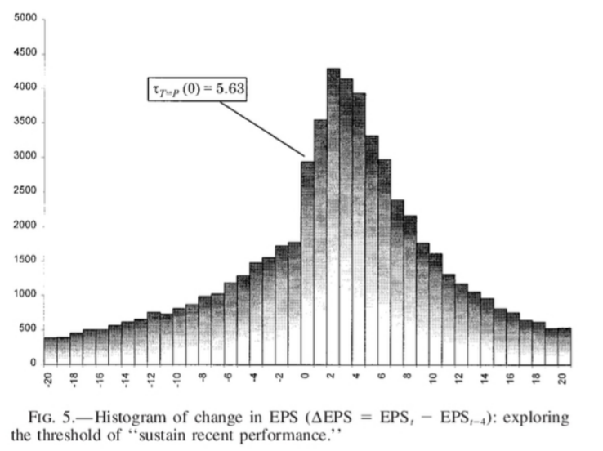
2. The door of Fraud
3. Earnings Management
1. Legal vs Ilegal
Evidence of the magnitude of earnings management
Degeorge, F., Patel, J., & Zeckhauser, R. (1999). Earnings Management to Exceed Thresholds. The Journal of Business, 72(1), 1–33. https://doi.org/10.1086/209601
4. Signals

Slide 17
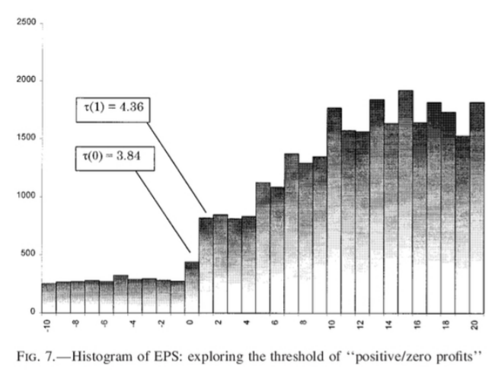
2. The door of Fraud
3. Earnings Management
1. Legal vs Ilegal
Evidence of the magnitude of earnings management
Degeorge, F., Patel, J., & Zeckhauser, R. (1999). Earnings Management to Exceed Thresholds. The Journal of Business, 72(1), 1–33. https://doi.org/10.1086/209601
4. Signals

Slide 18
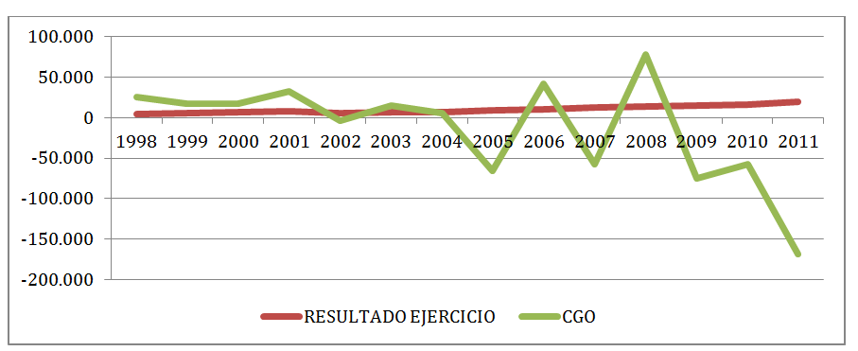
3. Earnings Management
4. Signals
2. The door of Fraud
1. Legal vs Ilegal
Qualitative signals
Voluntary change of auditor (26% of frauds, COSO 2012)
Too many complex operations with third parties and Tax paradise subsidiaries.
Problems in the Board of Directors or in the Auditing Committee.
The personality of leaders: language in meetings.
Financials statements
Changes in valuation rules (depreciation, provisions, expense capitalization)
Too much debt
Strong Differences between net profit and cash flow from operations
High off-balance sheet transactions
A big difference between earnings and Cash Flows
from Operations
Source: Villaescusa (2016)

Slide 19
3. Earnings Management
4. Signals
2. The door of Fraud
1. Legal vs Ilegal
Auditing costs
Auditing fee/Sales (much lower than competitors)
Days
Inventories, Customers, Suppliers (too high)
Assets turnover (too high)

Slide 20
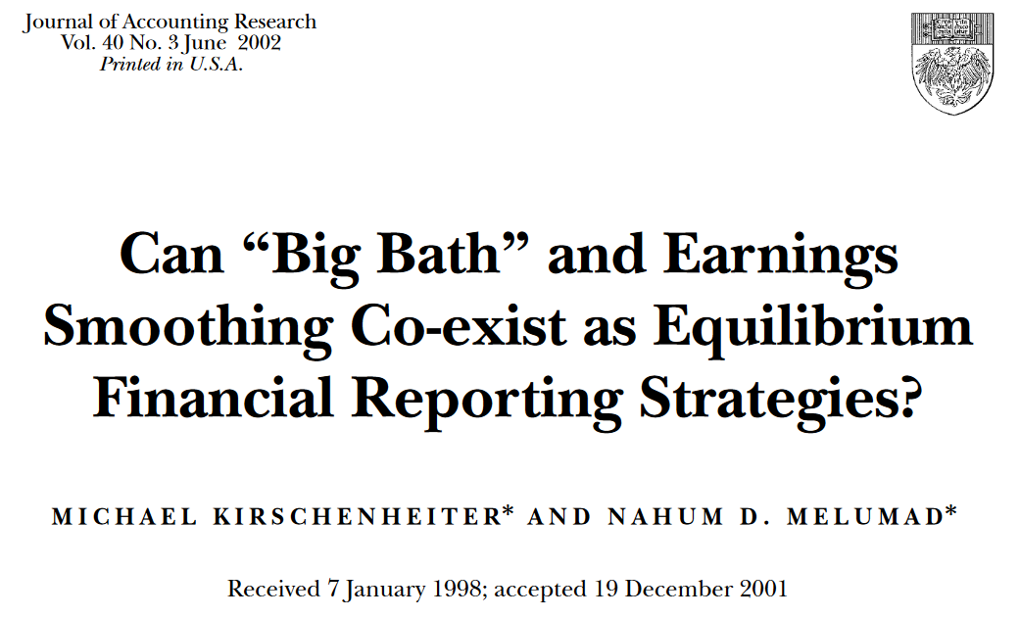
3. Earnings Management
4. Signals
2. The door of Fraud
1. Legal vs Ilegal
Is Earnings Management always a bad thing for investors?

Slide 21
3. Earnings Management
4. Signals
2. The door of Fraud
1. Legal vs Ilegal
Next class
2 individual presentations.
3-4 slides: an accounting fraud from your home country:
- company name, short background.
- the year of the fraud
- how? just a summary matching the alternatives presented in this topic.
- signals? just a summary matching the alternatives presented in this topic.

